Slide 1
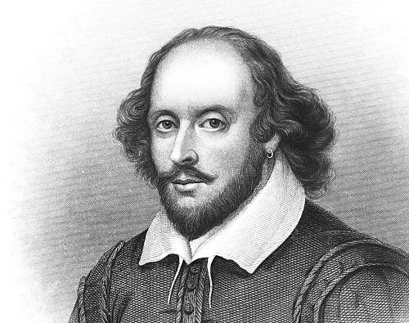
Shakespeare Analysis
Humza Salman
Devshan Renganathan

Slide 2
Agenda
Objective
Creating the graph
Analysis
Awesomeness
Conclusions and Next Steps

Slide 3
Objectives
To analyze William Shakespeare's poetry
Identify themes and the vocabulary used within them
Reveal underlying sentence structure
Do something cool with it

Slide 4
Getting the Data
Sourcing Data
Scraping Data
Poems
Storage
Poetry Foundation
“The Poetry Foundation recognizes the power of words to transform lives. We work to amplify poetry and celebrate poets by fostering spaces for all to create, experience, and share poetry.”
Beautiful Soup
Python package for parsing HTML
William Shakespeare
Found sonnets and poems authored by Shakespeare
.pkl file
Stored sonnets and poems into a pkl file

Slide 5
Lemmatization
The process of reducing a word to its root form
Shakespeare’s Lemmatized Words
study
studying
studies
studied
studier
clock
clocks
clock
study
kiss
kisses
kiss
rarity
rarities
rarity
lily
lilies
lily

Slide 6
Lemmatized Graph
English Stopwords:
Lyric
When I do count the clock that tells the time,
I | the | when | that
do | him | your | them
her | me | she | it
Word Tokenize
['when', 'i', 'do', 'count', 'the', 'clock', 'that', 'tells', 'the', 'time']
Filter Stopwords
['count', 'clock', 'tells', 'time']
Shakespeare’s Stopwords:
thy | thou | hath | doth
dost | wilt | thee | hast
art | ye | tis | shalt
count
clock
tells
time
Add to Graph
predecessor relationship

Slide 7
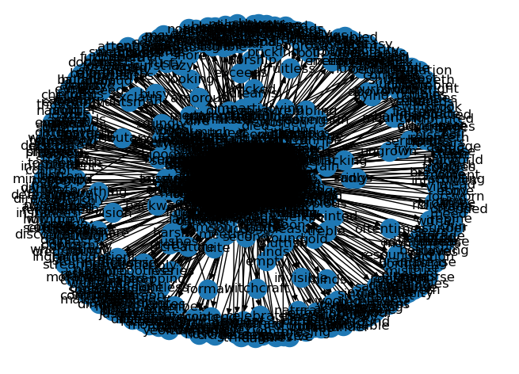
Lemmatized Graph
3893 Nodes
7653 Edges
54 Components
Weighted
Directed
The eye of Shakespeare

Slide 8
Analysis – Lemmatized Graph
Diameter
Degree Distribution
Centrality Measures
Community Detection
Vocabulary used
Word distribution
Theme identification
Vocabulary used within those themes

Slide 9
Analysis - Diameter
Largest component: 3775 nodes, 7586 edges
Diameter: 17
Path:
What does this tell us? Shakespeare has a large vocabulary and uses words with a variety of patterns.
Badness
Reign
Disturbing
Jealousy
Sour
Taste
Grief
One
Kiss
Main
Win
Wat'ry
Soil
Firm
Charm
Witchcraft
Sleep
Die

Slide 10
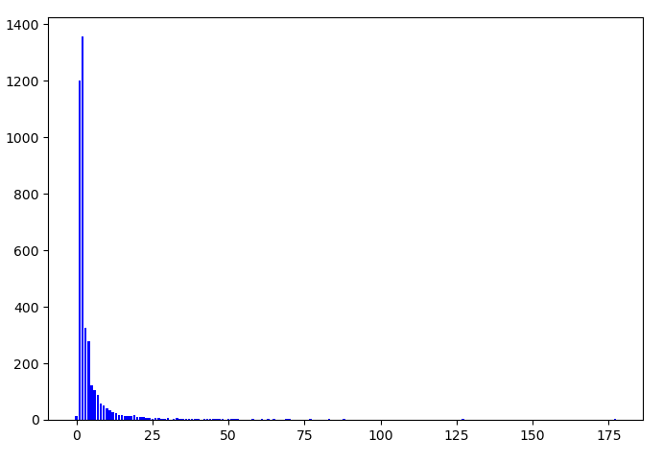
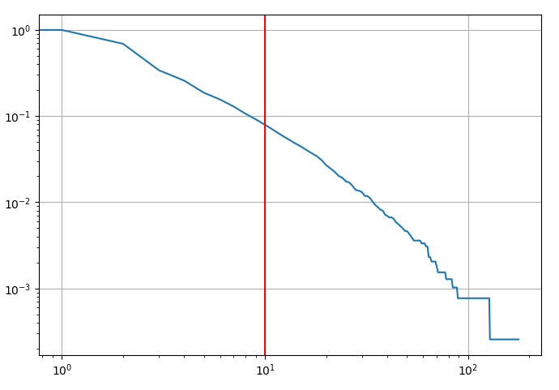
Analysis – Degree Distribution
Presence of hubs, but many more nodes that are used less frequently. Shakespeare has a large vocabulary, but clearly has a bank of 'favorite' words.
Using kmin = 10, alpha = 2.59 ± 0.09 - Scale free network.

Slide 11
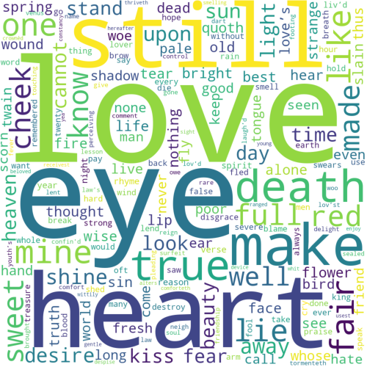
Analysis – Eigenvector Centrality
1. love (0.286098)​ 2. eye (0.221814)​ 3. heart (0.134575)​ 4. still (0.132140)​ 5. make (0.132095)​ 6. death (0.130121)​ 7. true (0.128537)​ 8. mine (0.128501)​ 9. fair (0.127708)​ 10. like (0.125725)​ 11. one (0.118967)​ 12. lie (0.113468)​ 13. sweet (0.100147)​ 14. full (0.099067)​ 15. red (0.098793)
What can we discern from this?
These words are highly influential in the network as they are connected to other important words.
Certain descriptive words are rated more highly because they neighbor the thematic words we want to isolate.
We need to exercise judgement in filtering these words to identify the true themes.

Slide 12
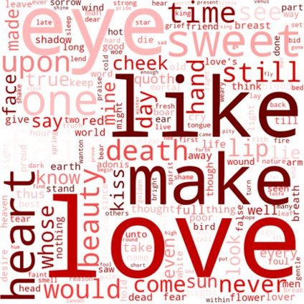
Analysis – Betweenness Centrality
1. love (0.107255)
2. eye (0.058201)
3. like (0.055665)
4. make (0.038301)
5. sweet (0.032326)
6. heart (0.030863)
7. one (0.028695)
8. fair (0.028045)
9. upon (0.025997)
10. time (0.025362)
11. beauty (0.023448)
12. death (0.023426)
13. still (0.021983)
14. would (0.019956)
15. see (0.018087)
What can we discern from this?
These words are highly influential in the network as they appear on more shortest paths between other pairs of nodes in the network.
These words are important in maintaining connectivity in the graph.
Looking for themes:
'Love' is the clearest theme.
'Time', 'Beauty', 'Death'
These match the themes typically associated with Shakespeare.

Slide 13
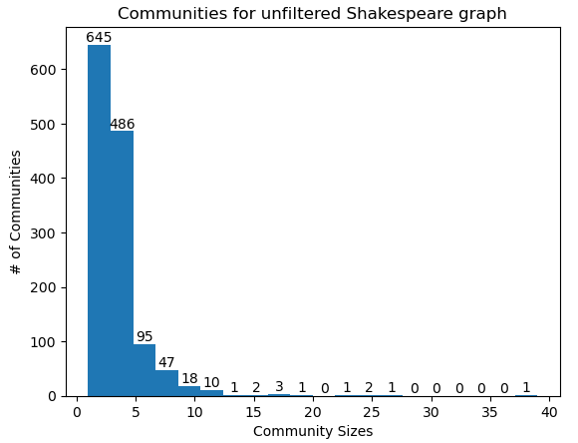
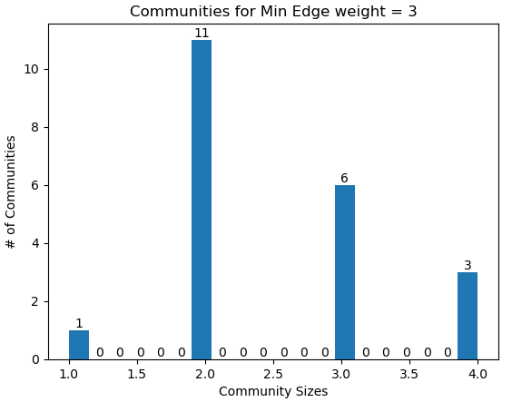
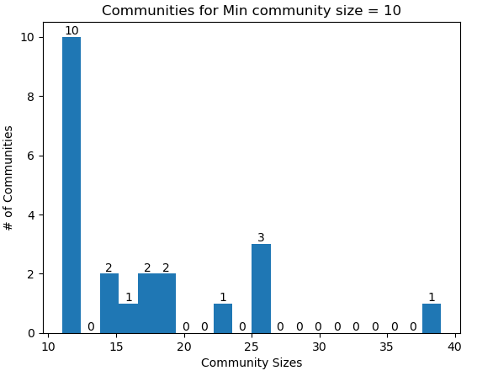
Analysis – Community Detection
Had to use the undirected version of the graph
Very few edges have a weight greater than 3 – The removal of 'stop-words' is the likely cause.
We focused on refining the community size thresholds to find higher quality communities.

Slide 14
Analysis – Community Detection
nx_comm.label_propagation_communities()
Best communities:
{'subtle', 'rolling', 'false', 'fickle', 'dart', 'creation', 'bethinking', 'adulterate', 'treacherous', 'belied', 'alarm', 'subtlety'}
{'cannon', 'near', 'brass', 'slain', 'eternal', 'died', "cancell'd", 'fond', 'hemm’d', 'reft', 'spite', 'deer', 'unkind', 'since', 'park', 'tomb'}
{'immortal', 'heard', 'kindness', 'threat', 'bolingbroke’s', 'lived', 'son', 'jolly', 'subtilty', 'fox', 'surpass', 'sweetest', 'woman’s', 'land', 'life', 'ivory', 'wall', 'provide', 'farewell'}
{'usest', 'reserve', 'smelling', 'number', 'yea', 'ranged', 'device', 'touching', 'judge', 'receivest', 'chiefly', 'love', 'tormenteth', 'beloved', 'she’s', 'despise', 'thriveth', 'hard-believing'}
Some interesting communities that could share a theme. A lot of very poor communities.
Betrayal?
Death? Evil?
Joy? Positivity?
Love?

Slide 15
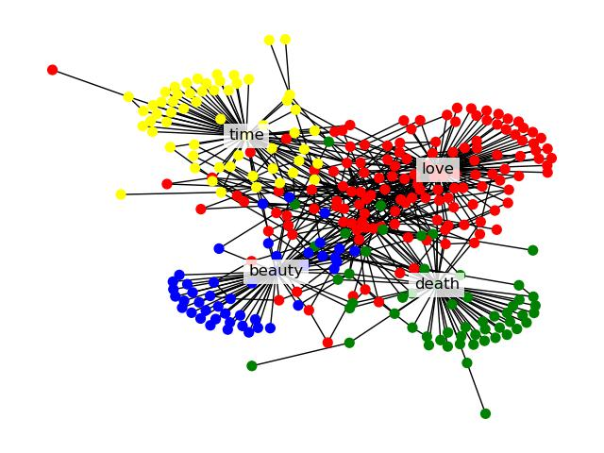
Analysis – Community Detection
Identify communities ourselves:
Reference words – Love, death, beauty, time
Define distances of each node to reference nodes
Create a dictionary with each node and its shortest path to each reference word
Identify communities based on the minimum shortest path
If no path exists, set a high distance value (1000)
Assign a color to each community

Slide 16
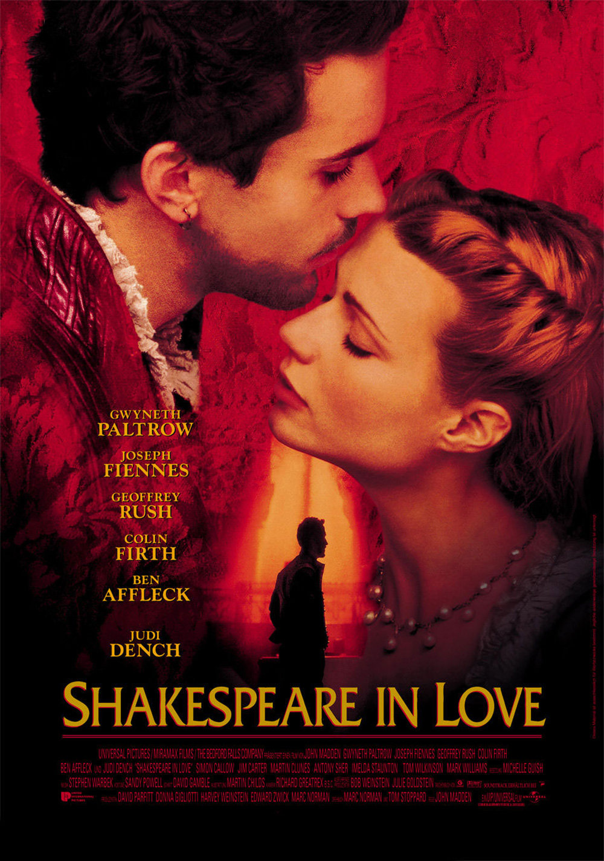
Analysis – Community Detection
Love community: ['whose', 'ah', 'see', 'fool', 'love', 'brought', 'spurns', 'happy', 'bond', 'upon', 'earth', 'two', "dispriz'd", 'without', 'desire', 'spring', 'war', 'wise', 'reason', 'love-sick', 'breedeth', 'eye', 'heart', 'footing', 'control', 'light', 'friendship', 'twain', 'gentle', 'shed', 'blame', 'break', 'make', 'keep', 'quick', 'away', 'disgrace', 'red', 'still', 'list', 'birth', 'full', 'shine', 'strong', 'god', 'judge', 'made', 'take', 'best', 'pleading', 'lie', 'lov’d', "law's", 'mine', 'live', 'pearl', 'strange', 'think', 'thus', 'know', 'saw', 'slain', 'look', 'leaf', 'comfort', 'home', 'sworn', 'choose', 'cannot', 'quoth', 'kill', 'want', 'fie', 'hear', 'spirit', 'cheek', 'call', 'well', 'love'r', 'heaven', 'seize', 'tormenteth', 'sweet', 'queen', 'oft', 'swears', 'age', 'true', 'alone', 'even', 'would', 'nothing', 'scorn', 'hate', 'laugh’d', 'leave', 'law', 'sorrow', 'night', 'forgoing', 'past', 'summer’s', 'day', 'time’s', 'green', 'forth', 'self', 'favour', 'heat', 'soul', 'poor', 'since', 'second', 'compound', 'writ', 'oblation', 'stand', 'hence', 'tree', 'simple', 'travel', 'friend', 'rain', 'beauteous', 'others', 'much', 'pay', 'truth', 'came', 'liv’d', 'cloud', 'dry', 'write', 'brave', 'scythe', 'white', 'year', 'form', 'behold', 'save']

Slide 17
Analysis – Community Detection
Death community: ['death', 'ravishment', 'something', 'dead', 'prime', 'fear', 'wail', 'wounding', 'unkind', 'churl', 'cry', 'part', 'lively', 'jest', 'outward', 'living', 'king', 'subscribes', 'sleep', 'story', 'dream', 'died', 'life', 'bloody', 'prophesy', 'lose', 'framing', 'bone', 'rise', 'reft', 'brag', 'exclaims', 'map', 'short', 'all-oblivious', 'lived', 'nature’s', 'thought', 'phoenix', 'feed', 'spite', 'humbly', 'court', 'way', 'restful', 'dusty', 'kind', 'survive', 'fresh', 'abuse', 'gainst', 'physic', 'brief', 'one', 'chides']
Beauty community: ['beauty', 'seems', 'seed', 'making', 'invisible', 'show', 'asked', 'true-sweet', 'strike', 'within', 'hold', 'statute', 'question', 'nought', 'wit', 'bred', 'twenty', 'proving', 'spoil', 'master', 'inward', 'forbid', 'seeing', 'shadow', 'succession', 'like', 'robb’d', 'infirmity', 'breath', 'eyeball', 'mingle', 'steal', 'forsake', 'buried', 'root', 'blotting', 'every', 'angry', 'stifle', 'enough', 'better', 'use', 'brings', 'set', 'rage']

Slide 18
Analysis – Community Detection
Time community: ['time', 'tell', 'go', 'face', 'prefiguring', 'golden', 'thousand', 'devouring', 'blunt', 'waste', 'sluttish', 'decease', 'line', 'piping', 'peace', 'balmy', 'despite', 'among', "summer's", 'debateth', 'woe', 'advantage', 'wasted', 'calumniating','count', 'hope', 'gave', 'reflect', 'horror', 'boast', 'old', 'wonder', 'need', 'spend', 'little', 'lord', 'transfix', 'recorded', 'precious', 'clock', "remov'd", 'come', 'play', 'right', 'grow’st', 'man', 'hour', 'ring', 'decay', 'spent', 'riper', 'glance', 'wasteful', 'present', 'sent', 'bettering', 'swift-footed', 'ruining', 'exchanged']
While these identified communities aren't perfect, we felt they more accurately captured the communities in this network.
These communities are directly tied to identified themes.

Slide 19
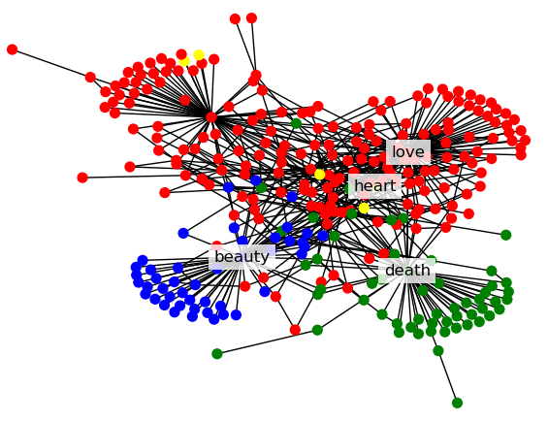
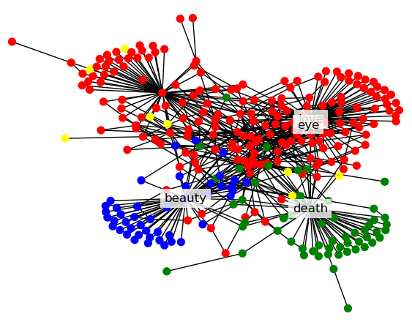
Analysis – Community Detection
Original themes
'Time' replaced with 'heart'
'Time' replaced with 'eye'
There are more communities that haven't been identified, so those words get lumped in with other themes.

Slide 20
Do Something Cool…
Shakespeare’s Sentence Structure
Eminem’s Words
PRP IN PRP$ NN NN PRP VBZ IN NN
It in my memory bank it stays on replay
VB DT TO VB PRP VBP PRP$ NN RB
Get this to go I want your number privately
DT NN IN NN CC VBD DT RB NN
The heart of gold but hooked a maybe floozy
NNS IN DT JJ NN IN NN TO NN
People with no prior record of violence to property
WP VBD JJ RB RBR IN JJ NN IN
What was last now’s more like adder’s root in
IN JJ PRP$ NN VBZ VBN IN JJ NN
In brief my penitence is paid in full bye-bye
CC RB VBD DT NN IN JJ JJ NNS
And then popped a couple of clean healthy ones
CC PRP TO WP NN NN PRP RB VBG
And me to who man it's you always worrying
CC IN DT NN WP$ NN VBZ VBG VB
But by the time whose mind is slipping slow
NNP RP IN JJ NNS RB IN PRP$ NN
Jesus down with little brothers back at his house
PRP VBP PRP$ NN IN VBG NNP PRP NN
I slits her throat while choking Hailie me name
TO PRP$ JJ NN IN IN PRP JJS JJ
To my left side of at it most extreme
IN WRB PRP VBD DT NN VBD VBN PRP
Like how they put a rat got killed it
CC RB PRP VBP CC NN VBD JJ NN
And sometimes I wonder and everything seemed fine yeah

Slide 21
What is Part of Speech (POS)?
A label that indicates syntactical function of the word in a sentence
Useful for analyzing sentence structure
Labels correspond to nouns, verbs, adjectives, prepositions, determiners, etc.
We utilize the Penn Treebank which has 36 varying POS labels
Lyric
When I behold the violet past prime,
When
I
behold
the
violet
past
prime
Word Tokenize
WRB
PRP
VBD
DT
NN
IN
JJ
Part of Speech

Slide 22
Part of Speech Graph
WRB
PRP
VBD
DT
NN
IN
JJ
Part of Speech
trigram
WRB PRP VBD
Edge Formed
DT NN IN
Graph Generation
PRP VBD DT
NN IN JJ
Edge Formed
Nodes = 3094 Edges = 7235
VBD DT NN
Nodes
No edge formed

Slide 23
Synthetic Shakespearean Sentences
WRB
PRP
VBD
DT
NN
IN
JJ
Part of Speech Tagged Lyric
Starting POS tags
“source”
Ending POS tags
“target”
Create Probability Table
WRB PRP VBD
NN IN JJ
('WRB PRP VBP', 'VBZ DT NN'): 0.0003957261574990107
('CC VB DT', 'IN JJ NN'): 0.0003957261574990107
('WRB PRP VBD', 'NN IN JJ'): 0.0003957261574990107
Paths with no repeated nodes
CDF
nx.all_simple_paths
PRP IN PRP$ NN NN PRP VBZ IN NN
VB DT TO VB PRP VBP PRP$ NN RB
Take maximum path weight
Prune
DT NN IN NN CC VBD DT RB NN
NNS IN DT JJ NN IN NN TO NN

Slide 24
OpenAI curie
Trained on Eminem’s Sentence Structure and Vocabulary
Fine-tuned OpenAI Curie Model
Synthetic Shakespeare Prompt
PRP IN PRP$ NN NN PRP VBZ IN NN
It in my memory bank it stays on replay

Slide 25
Conclusion and Future Work
Comparing Shakespeare’s Original Lyric and Eminem…
Lemmatization vs Stemming
Tradeoff with refining graph structure to graph analysis
Our Sentence Structure Analysis is still in its preliminary stage
Improving lyric generation to match syllables and structure of a sonnet
Use community detection and sentence structure to create interesting 'mixes'
POS | DT | NNS | WDT | VBD | DT | JJ | NNS | TO | VB
Shakespeare | Those | eyes | that | taught | all | other | eyes | to | see?
Eminem | These | beats | that | were | the | only | things | to | rap

Slide 26
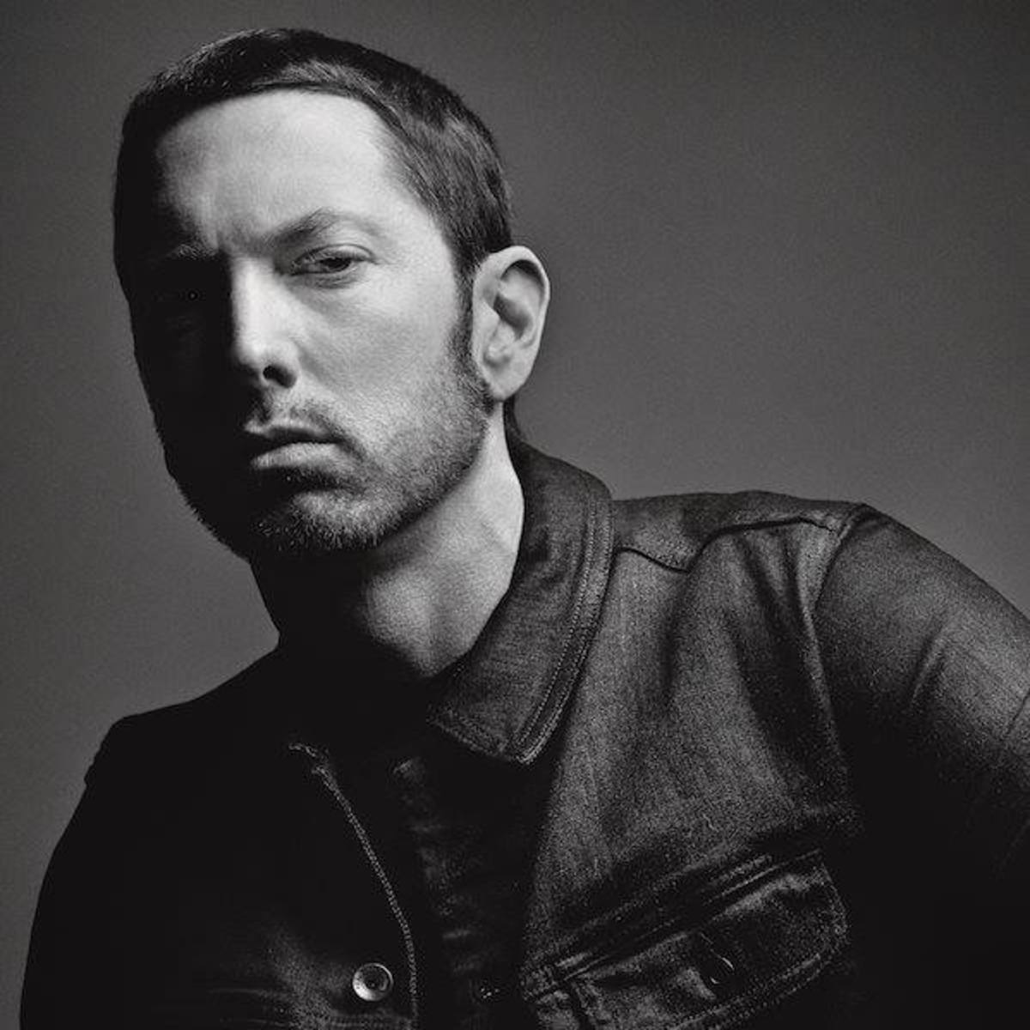
Questions?
Shakespeare’s Sentence Structure
Eminem’s Words
PRP IN PRP$ NN NN PRP VBZ IN NN
It in my memory bank it stays on replay
VB DT TO VB PRP VBP PRP$ NN RB
Get this to go I want your number privately
DT NN IN NN CC VBD DT RB NN
The heart of gold but hooked a maybe floozy
NNS IN DT JJ NN IN NN TO NN
People with no prior record of violence to property
WP VBD JJ RB RBR IN JJ NN IN
What was last now’s more like adder’s root in
IN JJ PRP$ NN VBZ VBN IN JJ NN
In brief my penitence is paid in full bye-bye
CC RB VBD DT NN IN JJ JJ NNS
And then popped a couple of clean healthy ones
CC PRP TO WP NN NN PRP RB VBG
And me to who man it's you always worrying
CC IN DT NN WP$ NN VBZ VBG VB
But by the time whose mind is slipping slow
NNP RP IN JJ NNS RB IN PRP$ NN
Jesus down with little brothers back at his house
PRP VBP PRP$ NN IN VBG NNP PRP NN
I slits her throat while choking Hailie me name
TO PRP$ JJ NN IN IN PRP JJS JJ
To my left side of at it most extreme
IN WRB PRP VBD DT NN VBD VBN PRP
Like how they put a rat got killed it
CC RB PRP VBP CC NN VBD JJ NN
And sometimes I wonder and everything seemed fine yeah

